Slide 1
Blue Mountain Resort
Targets for Next season

Slide 2
Context
Blue Mountain Resort, is one of the loveliest Ski Resort in the state of Montana offering scenic view of Glacier National Park and Flathead National Forest.
Almost 350,000 people visit every year, hence to increase the distribution of visitors across the mountain, additional chair lift were installed.
The business wants to be competitive of the ticket prices and also wants to increase the revenue

Slide 3
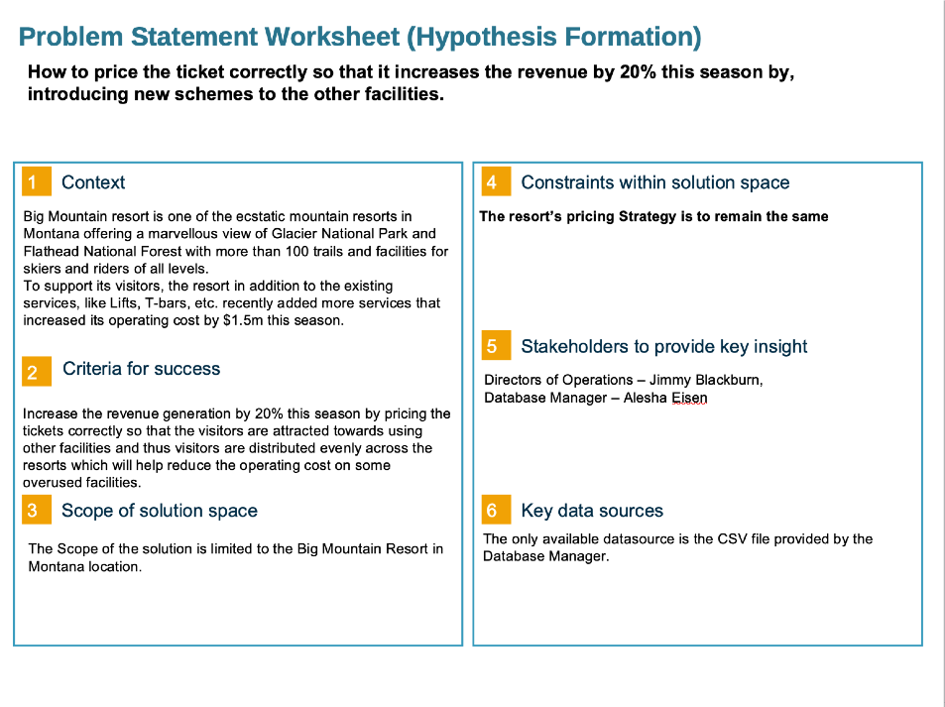

Slide 4
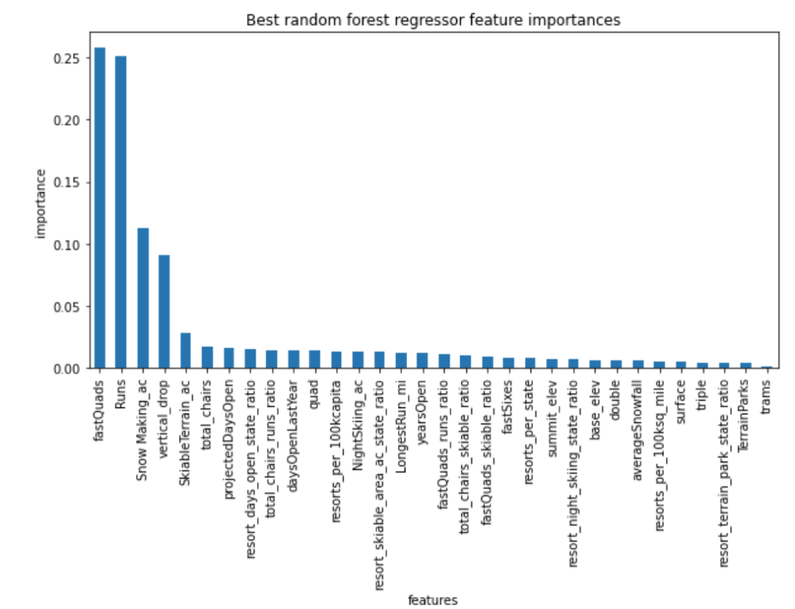
Key Findings:
Permanently closing down up to 10 of the least used runs. This doesn't impact any other resort statistics.
Increase the vertical drop by adding a run to a point 150 feet lower down but requiring the installation of an additional chair lift to bring skiers back up, without additional snow making coverage
Same as number 2, but adding 2 acres of snow making cover
Increase the longest run by 0.2 mile to boast 3.5 miles length, requiring an additional snow making coverage of 4 acres

Slide 5
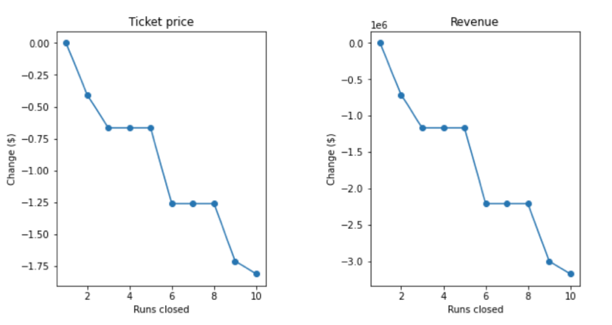
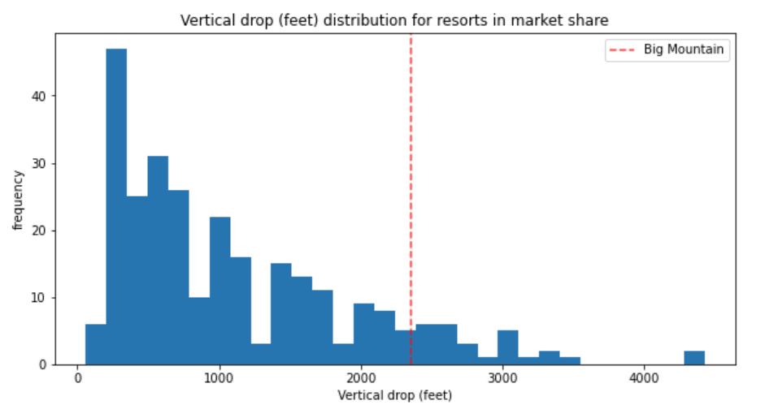
Model Findings:
Closing the 5 Runs will not impact revenue much.
Increasing the vertical drop by 150 increases the chance of raising the ticket price by $1.99 and exceeds the target of increasing the revenue by 50%.

Slide 6
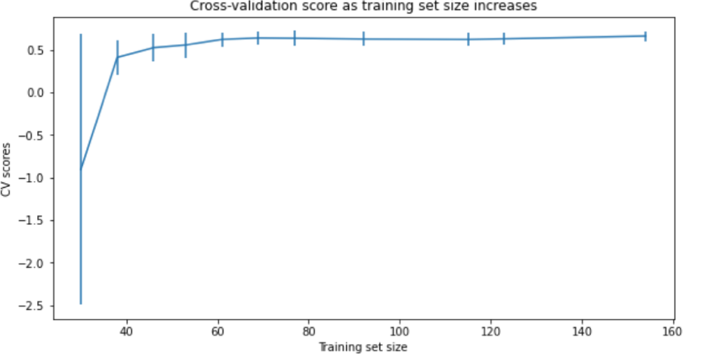
Conclusion:
We confirmed that our dataset was good enough to model.
We also found that the most relevant attraction is skiing and raising the vertical drop gives us a chance of raising the ticket price by not too much but it contributes to Revenue Increase by 50+%.

